Slide 1





Files and Streams
File Types, Using Streams, Manipulating Files
SoftUni Team
Technical Trainers
Software University
http://softuni.bg

Slide 2

Table of Contents
What are Files?
Binary and Text Files
What are Streams?
Stream Basics
Stream Types
File, Memory, Network Streams
Crypto, Gzip Streams
Readers and Writers
File and Directory Operations

Slide 3

Files
What are Files?

Slide 4

Files
A file is a resource for storing information
Located on a storage device (e.g. hard-drive)
Has name, size, extension and contents
Stores information as series of bytes
Two file types – text and binary

Slide 5
Text Files
Text files contain text information
Store text differently according to the encoding
E.g. in ASCII (0..127 codes) a character is represented by 1 byte
In UTF8 (0..65535 codes) a character is represented by 1-4 bytes
F i l e
46 | 69 | 6c | 65
Header bytes
С м я х
ef | bb | bf | d0 | a1 | d0 | bc | d1 | 8f | d1 | 85

Slide 6
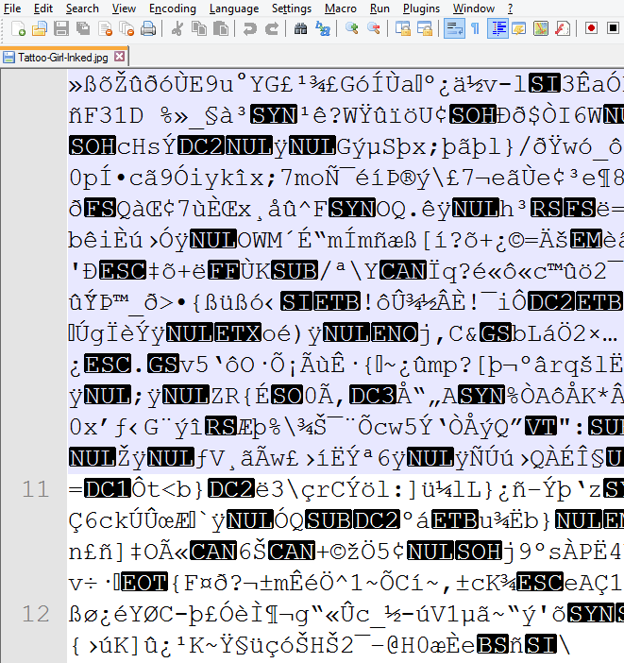

Binary Files
Binary files store raw sequences of bytes
Can contain any data (images, sound, multimedia, etc.)
Not human-readable

Slide 7

Text and Binary Files
Live Demo in Hex Editor

Slide 8

What Is Stream?
Streams Basic Concepts

Slide 9



What is Stream?
Stream is the natural way to transfer data in the computer world
To read or write a file, we open a stream connected to the file and access the data through the stream
Input stream
Output stream

Slide 10
Streams Basics
Streams are means for transferring (reading and writing) data into and from devices
Streams are ordered sequences of bytes
Provide consecutive access to its elements
Different types of streams are available to access different data sources:
File access, network access, memory streams and others
Streams are opened before using them and closed after that

Slide 11
Stream – Example
Length = 9
Position is the current position in the stream
Buffer keeps the current position + n bytes of the stream
F i l e s a n d
46 | 69 | 6c | 65 | 73 | 20 | 61 | 6e | 64
Position
Buffer
46 | 69
6c | 65
73 | 20
61 | 6e
64

Slide 12
Stream Types in .NET
Base streams
Read and write data from and to external data storage mechanisms
FileStream, MemoryStream, NetworkStream
Pass-through streams
Read and write from and to other streams
Give additional functionality (buffering, compression, encryption)
BufferedStream and CryptoStream

Slide 13

Base Streams
File, Memory, Network

Slide 14
The System.IO.Stream Class
The base class for all streams is the abstract class System.IO.Stream
There are defined methods for the main operations with streams in it
Some streams do not support read, write or positioning operations
Properties CanRead, CanWrite and CanSeek are provided
Streams which support positioning have the properties Position and Length

Slide 15
Methods of System.IO.Stream Class
int Read(byte[] buffer, int offset, int count)
Read as many as count bytes from input stream, starting from the given offset position
Returns the number of read bytes or 0 if end of stream is reached
Can freeze for undefined time while reads at least 1 byte
Can read less than the claimed number of bytes

Slide 16
Methods of System.IO.Stream Class (2)
Write(byte[] buffer, int offset, int count)
Writes to output stream sequence of count bytes, starting from the given offset position
Can freeze for undefined time, until send all bytes to their destination
Flush()
Sends the internal buffers data to its destination (data storage, I/O device, etc.)

Slide 17
Methods of System.IO.Stream Class (3)
Close()
Calls Flush()
Closes the connection to the device (mechanism)
Releases the used resources
Seek(offset, SeekOrigin) – moves the position (if supported) with given offset towards the beginning, the end or the current position

Slide 18
Buffered Streams
Buffer the data and effectively increase performance
Call for read of even 1 byte makes read of more kilobytes in advance
The stream keeps them in an internal buffer
Next read returns data from the internal buffer
Very fast operation

Slide 19
Buffered Streams (2)
Written data is stored in internal buffer
Very fast operation
When buffer overloads:
Flush() is called
The data is sent to its destination
In .NET we use the System.IO.BufferedStream class

Slide 20



File Stream

Slide 21
The FileStream Class
Inherits the Stream class and supports all its methods and properties
Supports reading, writing, positioning operations, etc.
The constructor contains parameters for:
File name
File open mode
File access mode
Competitive users access mode

Slide 22
The FileStream Class (2)
FileMode – opening file mode
Open, Append, Create, CreateNew, OpenOrCreate,Truncate
FileAccess – operations mode for the file
Read, Write, ReadWrite
FileShare – access rules for other users while file is opened
None, Read, Write, ReadWrite
FileStream fs = new FileStream(string fileName, FileMode
[,FileAccess [, FileShare]]);
Optional parameters

Slide 23
Writing Text to File – Example
string text = "Кирилица";
var fileStream = new FileStream("../../log.txt", FileMode.Create);
try
{
byte[] bytes = Encoding.UTF8.GetBytes(text);
fileStream.Write(bytes, 0, bytes.Length);
}
finally
{
fileStream.Close();
}
Using try-finally guarantees the stream will always close
Encoding.UTF8.GetBytes() returns the underlying bytes of the character

Slide 24
Copying File – Example
using (var source = new FileStream(DuckImagePath, FileMode.Open))
{
using (var destination =
new FileStream(DestinationPath, FileMode.Create))
{
byte[] buffer = new byte[4096];
while (true)
{
int readBytes = source.Read(buffer, 0, buffer.Length);
if (readBytes == 0)
break;
destination.Write(buffer, 0, readBytes);
}
}
}
using automatically closes the stream

Slide 25
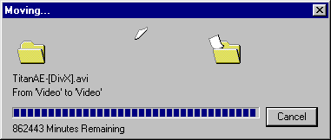
Copying a File
Live Demo

Slide 26



Memory Stream

Slide 27
Reading In-Memory String – Example
string text = "In-memory text.";
byte[] bytes = Encoding.UTF8.GetBytes(text);
using (var memoryStream = new MemoryStream(bytes))
{
while (true)
{
int readByte = memoryStream.ReadByte();
if (readByte == -1)
{
break;
}
Console.WriteLine((char) readByte);
}
}

Slide 28

Memory Stream
Live Demo

Slide 29
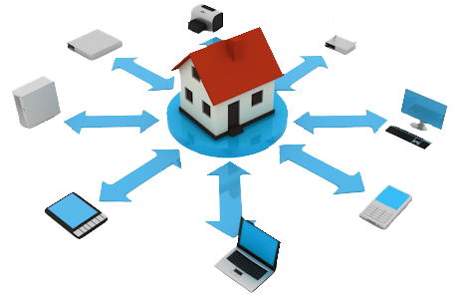
Network Stream

Slide 30
Simple Web Server – Example
var tcpListener = new TcpListener(IPAddress.Any, PortNumber);
tcpListener.Start();
Console.WriteLine("Listening on port {0}...", PortNumber);
while (true)
{
using (NetworkStream stream = tcpListener.AcceptTcpClient().GetStream())
{
byte[] request = new byte[4096];
stream.Read(request, 0, 4096);
Console.WriteLine(Encoding.UTF8.GetString(request));
string html = string.Format("{0}{1}{2}{3} - {4}{2}{1}{0}",
"<html>", "<body>", "<h1>", "Welcome to my awesome site!", DateTime.Now);
byte[] htmlBytes = Encoding.UTF8.GetBytes(html);
stream.Write(htmlBytes, 0, htmlBytes.Length);
}
}
Gets the stream
Reads request
Writes response

Slide 31
Network Stream
Live Demo

Slide 32

Readers and Writers
StreamReader, Binaryreader, StreamWriter, BinaryWriter

Slide 33
Readers and Writers
Readers and writers are classes which facilitate the work with streams
Two types
Text readers/writers – StreamReader / StreamWriter
Provide methods .ReadLine(), .WriteLine() (similar to working with Console.*)
Binary readers/writers – BinaryReader / BinaryWriter
Provide methods for working with primitive types – .ReadInt32(), .ReadBoolean(), WriteChar(), etc.

Slide 34
Reading From File
Read and display text file line by line using StreamReader
StreamReader reader = new StreamReader("somefile.txt");
using (reader)
{
int lineNumber = 0;
string line = reader.ReadLine();
while (line != null)
{
lineNumber++;
Console.WriteLine("Line {0}: {1}", lineNumber, line);
line = reader.ReadLine();
}
}

Slide 35
Writing Reversed Text to File – Example
using (var reader = new StreamReader("../../Program.cs"))
{
using (var writer = new StreamWriter("../../reversed.txt"))
{
string line = reader.ReadLine();
while (line != null)
{
for (int i = line.Length - 1; i >= 0; i--)
{
writer.Write(line[i]);
}
writer.WriteLine();
line = reader.ReadLine();
}
}
}

Slide 36

Readers and Writers
Live Demo

Slide 37

Fixing Movie Subtitles
Live Demo

Slide 38
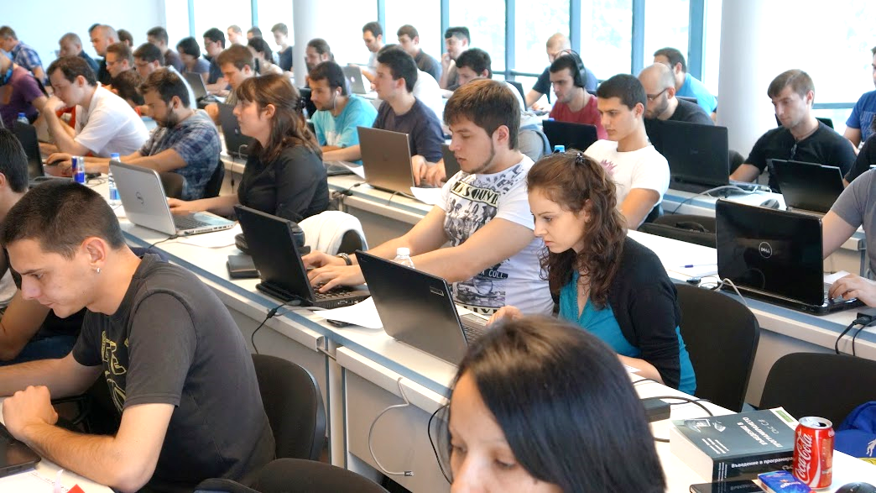
Exercises in Class

Slide 39

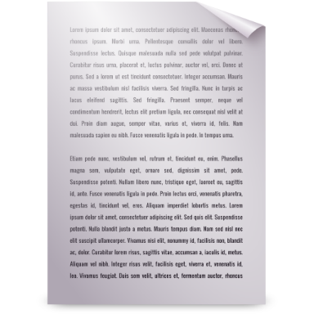

Other Streams
.NET supports special streams
Work just like normal streams, but provide additional functionality
E.g. CryptoStream encrypts when writing, decrypts when reading
GzipStream compresses/decompresses data
PipedStream allows reading/writing data across multiple processes
Input Stream
Output Stream

Slide 40

Other Streams
Live Demo

Slide 41
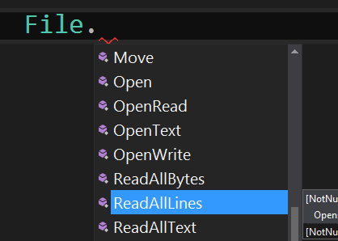
File Class in .NET
Easily Working With Files

Slide 42
File Class in .NET
File is a static class that provides methods for quick and easy manipulation of files
ReadAllText() / WriteAllText() – reads/writes everything at once
Move() – moves a file to the specified destination
Create() – creates a new file and opens a FileStream to it
Delete() – deletes an existing file
Exists() – checks if such a file exists

Slide 43
Working With Files – Example
string text = File.ReadAllText(FilePath);
Console.WriteLine(text);
File.WriteAllText("../../new.txt", "New line");
bool fileExists = File.Exists("../../Program.cs");
Console.WriteLine(fileExists);
var fileStream = File.Create("temp.bin");
fileStream.Close();
File.Move("temp.bin", "renamed.bin");
File.Delete("renamed.bin");

Slide 44
Working With Directories And Files – Example
var info = new FileInfo("../../Program.cs");
Console.WriteLine(
"Name: {0}, Extension: {1}, Size: {2}b, Last Accessed: {3}",
info.Name, info.Extension, info.Length, info.LastAccessTime);
string[] files = Directory.GetFiles(Directory.GetCurrentDirectory());
foreach (var file in files)
{
Console.WriteLine(file);
}
string path = Environment.GetFolderPath(
Environment.SpecialFolder.Desktop);
Console.WriteLine(path);

Slide 45

Summary
Streams are ordered sequences of bytes
Serve as I/O mechanisms
Can be read or written to (or both)
Can have any nature – file, network, memory,
device, etc.
Reader and writers facilitate the work with streams by providing additional functionality (e.g. reading entire lines at once)
Always close streams by putting using(…) or
try-finally

Slide 46









Strings and Text Processing
https://softuni.bg/courses/advanced-csharp

Slide 47
License
This course (slides, examples, demos, videos, homework, etc.) is licensed under the "Creative Commons Attribution-NonCommercial-ShareAlike 4.0 International" license
Attribution: this work may contain portions from
"Fundamentals of Computer Programming with C#" book by Svetlin Nakov & Co. under CC-BY-SA license
"C# Part I" course by Telerik Academy under CC-BY-NC-SA license
"C# Part II" course by Telerik Academy under CC-BY-NC-SA license

Slide 48





Free Trainings @ Software University
Software University Foundation – softuni.org
Software University – High-Quality Education, Profession and Job for Software Developers
softuni.bg
Software University @ Facebook
facebook.com/SoftwareUniversity
Software University @ YouTube
youtube.com/SoftwareUniversity
Software University Forums – forum.softuni.bg

